Slide 1
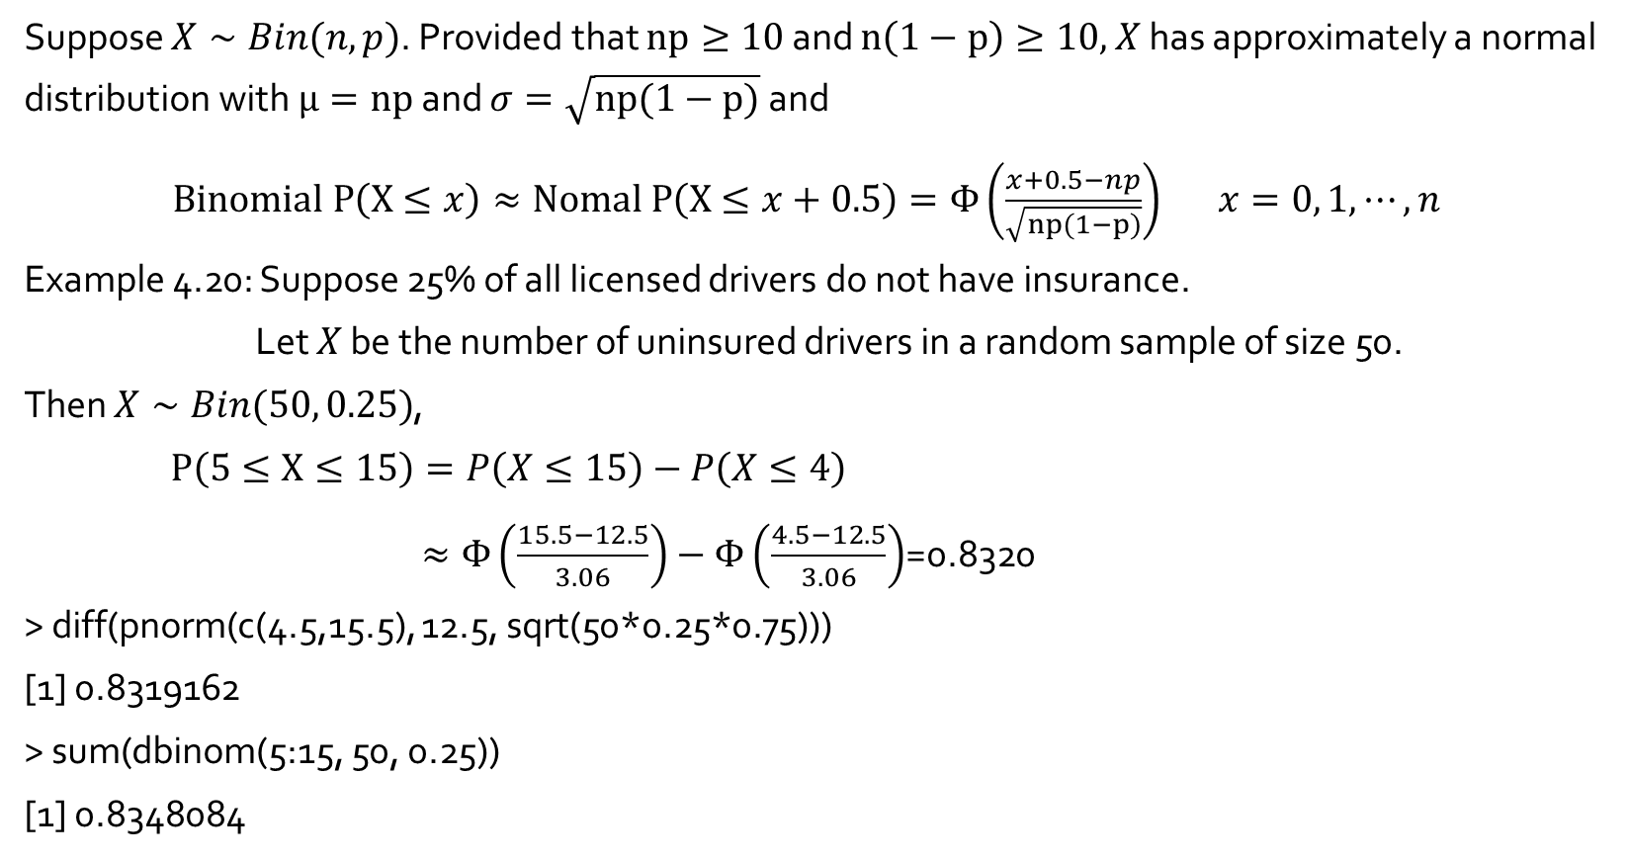
Normal approximation to binomial
Suppose $X∼Bin(n, p)$. Provided that $np≥10$ and $n\left(1−p\right)≥10,$ $X$ has approximately a normal distribution with $μ=np$ and $σ=\sqrt{np(1−p)}$ and
$Binomial P\left(X≤x\right)≈Nomal P\left(X≤x+0.5\right)=Φ\left(\frac{x+0.5−np}{\sqrt{np(1−p)}}\right)$ $x=0, 1, ⋯, n$
Example 4.20: Suppose 25% of all licensed drivers do not have insurance.
Let $X$ be the number of uninsured drivers in a random sample of size 50.
Then $X∼Bin(50, 0.25)$,
$P\left(5≤X≤15\right)=P\left(X≤15\right)−P\left(X≤4\right)$
$≈Φ\left(\frac{15.5−12.5}{3.06}\right)−Φ\left(\frac{4.5−12.5}{3.06}\right)$=0.8320
> diff(pnorm(c(4.5,15.5), 12.5, sqrt(50*0.25*0.75)))
[1] 0.8319162
> sum(dbinom(5:15, 50, 0.25))
[1] 0.8348084

Slide 2
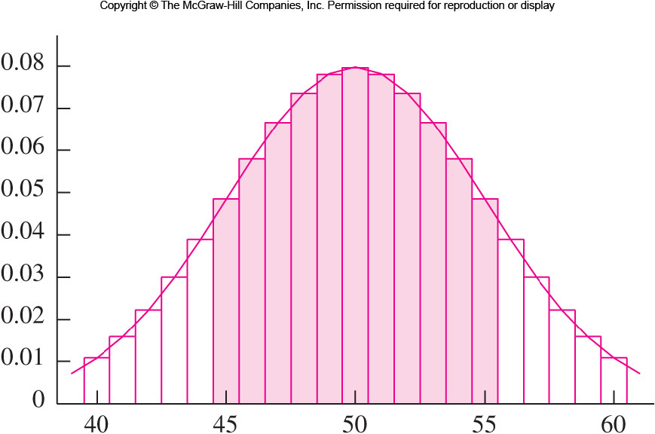
Binomial : P(45$≤X≤55)↔$Normal : P(44$.5≤X≤55.5)$

Slide 3
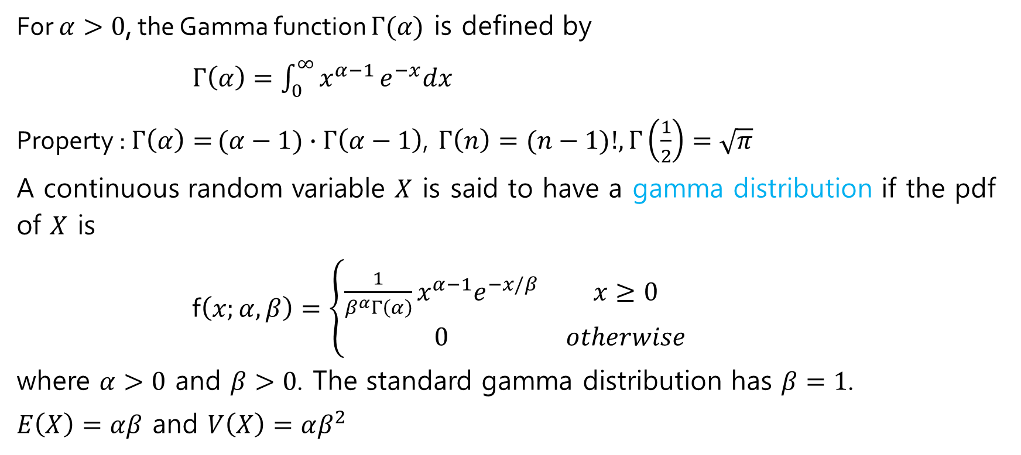
The Gamma distribution
For $α>0$, the Gamma function $Γ(α)$ is defined by
$Γ\left(α\right)=\int_{0}^{∞}{x^{α−1}}e^{−x}dx$
Property : $Γ\left(α\right)=$ $(α−1)∙$ $Γ\left(α−1\right)$, $Γ\left(n\right)=(n−1)!, Γ\left(\frac{1}{2}\right)=\sqrt{π}$
A continuous random variable $X$ is said to have a gamma distribution if the pdf of $X$ is
f$\left(x;α, β\right)=\left\{\begin{matrix}\frac{1}{β^{α}Γ\left(α\right)}x^{α−1}e^{−x/β} & x≥0 \\ 0 & otherwise\end{matrix}\right.$
where $α>0$ and $β>0$. The standard gamma distribution has $β=1$.
$E\left(X\right)=αβ$ and $V\left(X\right)=αβ^{2}$

Slide 4
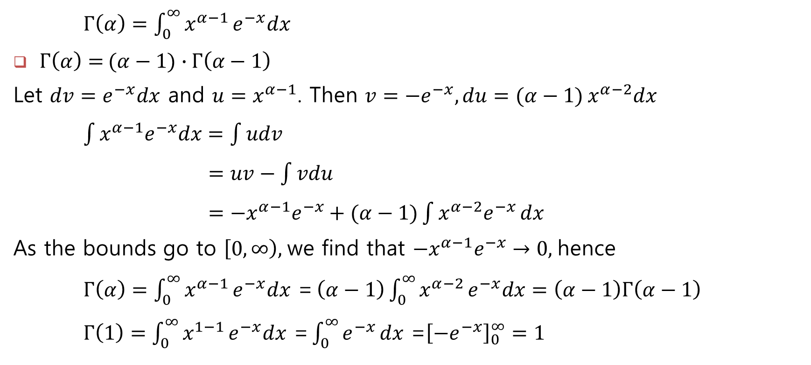
The Gamma function**
$Γ\left(α\right)=\int_{0}^{∞}{x^{α−1}}e^{−x}dx$
$Γ\left(α\right)=$ $(α−1)∙$ $Γ\left(α−1\right)$
Let $dv=e^{−x}dx$ and $u=x^{α−1}$. Then $v={−e}^{−x}, du=(α−1)$ $x^{α−2}dx$
$\int{x^{α−1}e^{−x}dx}=\int{udv}$
$=uv−\int{vdu}$
$=−x^{α−1}e^{−x}+(α−1)\int{x^{α−2}e^{−x}}dx$
As the bounds go to $\left[0, ∞\right),$we find that $−x^{α−1}e^{−x}→0,$hence
$Γ\left(α\right)=\int_{0}^{∞}{x^{α−1}}e^{−x}dx \text{=}$ $\left(α−1\right)\int_{0}^{∞}{x^{α−2}}e^{−x}dx=\left(α−1\right)Γ\left(α−1\right)$
$Γ\left(1\right)=\int_{0}^{∞}{x^{1−1}}e^{−x}dx\text{ =}\int_{0}^{∞}{e^{−x}}dx\text{ =}{\left[−e^{−x}\right]}_{0}^{∞}=1$

Slide 5
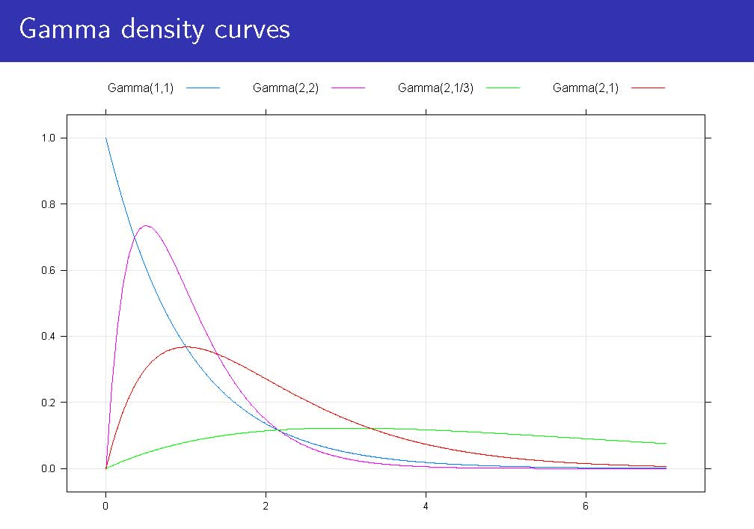
Gamma density curves

Slide 6
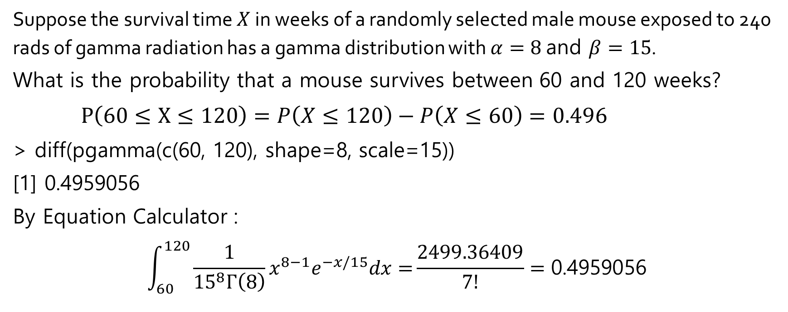
Probabilities from the gamma distribution : Example 4.21
Suppose the survival time $X$ in weeks of a randomly selected male mouse exposed to 240 rads of gamma radiation has a gamma distribution with $α=8$ and $β=15$.
What is the probability that a mouse survives between 60 and 120 weeks?
$P\left(60≤X≤120\right)=P\left(X≤120\right)−P\left(X≤60\right)=0.496$
> diff(pgamma(c(60, 120), shape=8, scale=15))
[1] 0.4959056
By Equation Calculator :
$$\int_{60}^{120}{\frac{1}{{15}^{8}Γ\left(8\right)}x^{8−1}e^{−x/15}dx=}\frac{2499.36409}{7!}=\text{0.4959056}$$

